Slide 1

INTRODUCTION TO PACKAGE DEVELOPMENT IN R
April 10, 2021
11:00 am - 1:00 pm (GMT +3)

Slide 2
Agenda
Time | Activity | Speaker/ Moderator
11:00 am – 11:05 am | Participants joining
11:05 am – 11:10 am | Welcoming remarks and introducing the speaker | Lucy Njoki
11:10 am – 12:25 pm | Introduction to package development in R | Shelmith Kariuki
12:25 pm – 12: 55 pm | Q & A | Shelmith Kariuki & Lucy Njoki
12:55 pm – 13: 00 pm | Closing remarks | Lucy Njoki

Slide 3
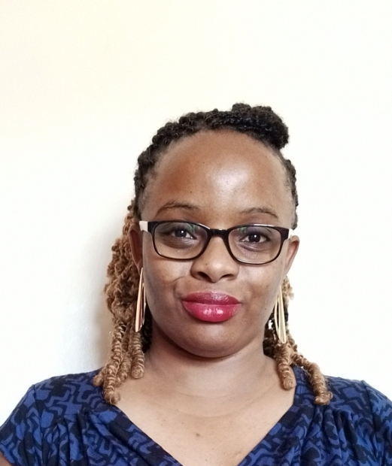
Our Trainer
Shelmith Kariuki
Data Analytics Consultant

Slide 4
Training Session

Slide 5
Q & A

Slide 6
Upcoming Monthly Meetup

Slide 7
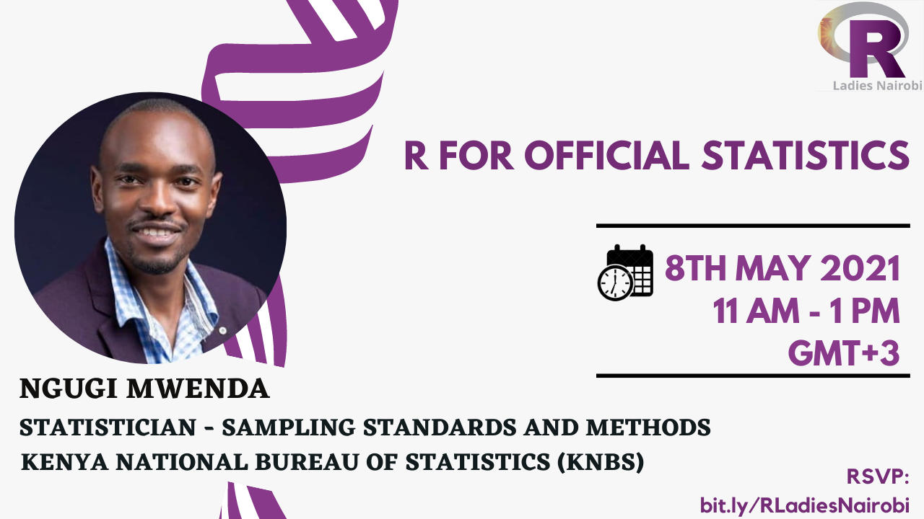

Slide 8
THANK YOU
Email address: nairobi@rladies.org
LinkedIn: R-Ladies Nairobi
Twitter: @RLadiesNairobi
Meetup: https://www.meetup.com/rladies-nairobi/

